Slide 1




NEWTON
SQL PROJECT
BANK CRM
CUSTOMER RELATIONSHIP MANAGEMENT

Slide 2


CONTENT
01
02
03
04
05
Introduction
Data Overview
Data Cleaning and Preparation
Objective Analysis
Subjective Analysis
06
07
08
09
10
Credit Score Churn Ranking
Churn Rate
Key Findings
Recommendations and Conclusion
Power BI report

Slide 3
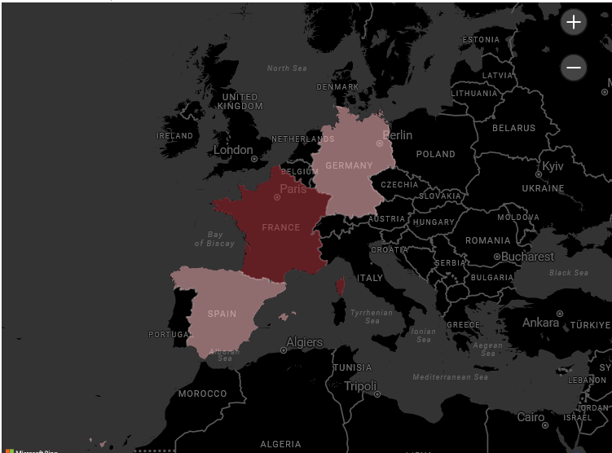


INTRODUCTION
This project delves into the complex realm of customer churn within the banking sector, seeking to understand the factors influencing customer attrition and devising strategies for retention. By leveraging SQL, we meticulously analyse customer demographics, account details, and transactional behaviors to uncover insights that drive churn
Through this exploration, we aim to equip businesses with actionable recommendations to foster customer loyalty and drive sustainable growth in the competitive banking landscape.

Slide 4




DATA OVERVIEW
Dataset Composition
Customer Information
Transactional Data
Data Structure
The dataset comprises seven tables including "CustomerInfo," "Churn," and "ActiveCustomer," offering comprehensive insights into customer demographics and banking metrics.
"CustomerInfo" contains vital details like customer IDs, age, and estimated salary, forming the foundation for analyzing customer behavior and churn patterns.
Metrics such as account balances, tenure, and product holdings provide insights into customer engagement and financial behavior, aiding in churn prediction.
Predominantly categorical variables enable segmentation by geographic regions, gender, and credit score brackets, while continuous variables offer deeper analysis potential.

Slide 5



DATA CLEANING AND PREPARATION
Handling Missing Values:
Identified and removed missing values in the active customers
Data Consistency:
Cleaned special characters from the Surname column using string manipulation functions.
Ensured correct data types for critical columns:
Converted numeric values in the Bank_DOJ column to date format.
Converted numeric values in the Age column to text format.
Inconsistency Correction:
Detected and rectified 735 rows where exited customers were incorrectly marked as active.
SQL query used to update the IsActiveMember column for accurate churn status.

Slide 6

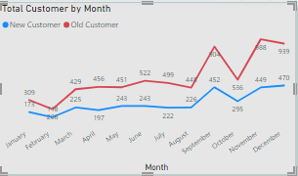
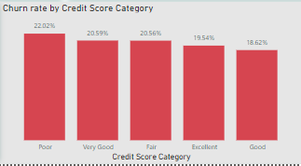
OBJECTIVE ANALYSIS - OVERVIEW
Key Objectives and Insights:
Account Balance Distribution: Analyzed total, average, max, and min balances across France, Spain, and Germany.
Top Salaries: Identified top 5 customers with highest estimated salaries in the last quarter.
Credit Card Usage: Found that customers with a credit card use an average number of products.
Churn Rate by Gender: Calculated churn rates for female and male customers for the most recent year.
Credit Score Comparison: Compared average credit scores between exited and retained customers.
Gender-wise Income and Active Accounts: Found that females have a higher average estimated salary.
Credit Score and Exit Rate: Customers with a credit score below 580 have the highest exit rate.
Active Customers by Region: France has the most active customers with a tenure > 5 years.
Credit Card Impact on Churn: Both credit card holders and non-holders show similar churn rates.
Common Products Among Exited Customers: Identified most frequent number of products used by exited customers.
Customer Acquisition Trend: Steady increase over the years, with peaks in November and December.

Slide 7








SUBJECTIVE ANALYSIS - OVERVIEW
Engagement Through Products
Activity and Exit Discrepancies
Customer Lifetime Value
Customers who engage with more bank products are less likely to churn, highlighting the importance of cross-selling.
Understanding the average tenure and balance of customers provides insights into customer lifetime value and retention strategies.
Data discrepancies, such as exited customers marked as active, need resolution to ensure accurate analysis.
Churn Prediction Factors
Geographic Influence
Income vs. Balance Correlation
Variables like balance, estimated salary, and credit score are crucial in predicting customer churn.
Regional differences in customer behaviour and balances suggest the need for tailored regional strategies.
Weak correlation between salary and balance suggests other factors significantly influence balance.

Slide 8

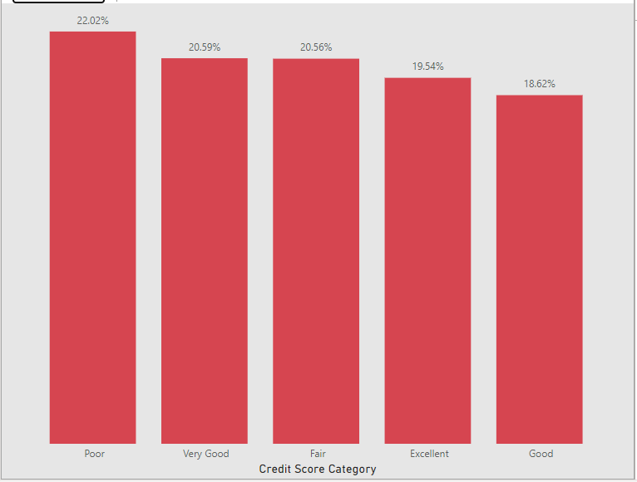


CREDIT SCORE CHURN RANKING
Credit Score Segmentation:
Categories: Customers were segmented into five credit score categories: Poor (<580), Fair (580-669), Good (670-739), Very Good (740-799), and Excellent (800+).
Churn Ranking:
Fair Credit Score: The 'Fair' credit score segment (580-669) had the highest number of churned customers, with 685 customers exiting.
Poor Credit Score: The 'Poor' credit score segment (<580) followed, with 520 churned customers.
Good Credit Score: The 'Good' segment (670-739) had 452 churned customers.
Very Good Credit Score: The 'Very Good' segment (740-799) had 252 churned customers.
Excellent Credit Score: The 'Excellent' segment (800+) had the fewest churned customers, with 128 exits.
Key Insights:
Higher Churn Rates in Lower Scores: Customers with lower credit scores (Fair and Poor) are more likely to churn compared to those with higher scores.
Loyalty in Higher Scores: Customers with higher credit scores (Very Good and Excellent) show greater loyalty and lower churn rates.

Slide 9
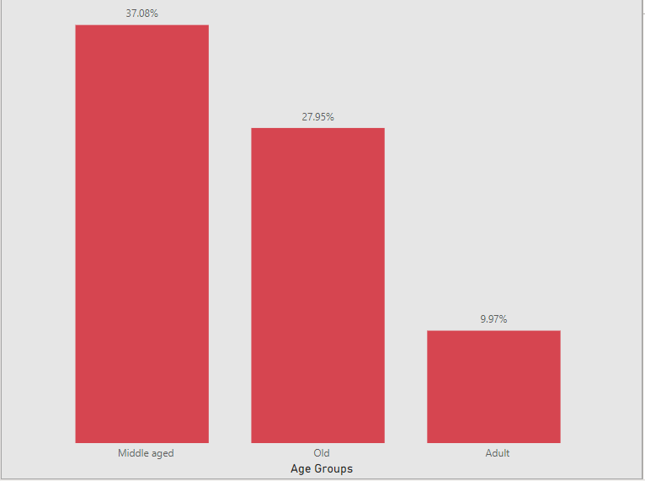
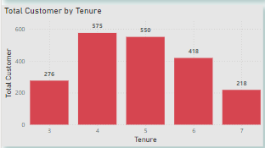
CHURN RATE
AGE GROUP
Analysis Overview:
Examined churn rates across different age groups to understand demographic trends.
Key Insights:
18-30 Age Group: Identified as having the highest churn rate at 28.5%.
30-50 Age Group: Showed a moderate churn rate of 22.1%.
50+ Age Group: Had the lowest churn rate at 14.8%.
TENURE ANALYSIS
Analysis Overview:
Investigated the relationship between customer tenure and churn rate.
Key Insights:
Less Than 2 Years Tenure: Recorded the highest churn rate at 31.2%.
2-5 Years Tenure: Showed a moderate churn rate of 21.9%.
More Than 5 Years Tenure: Had the lowest churn rate at 12.4%.

Slide 10
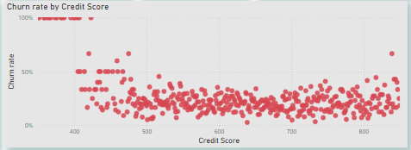
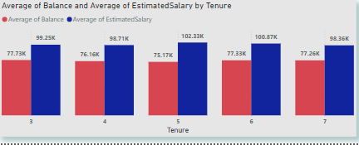
KEY FINDINGS
Discover the pivotal insights garnered from our comprehensive analysis, amalgamating both objective statistical examinations and subjective investigative approaches. Unveil the critical revelations influencing bank churn dynamics and strategic decision-making.
Objective Analysis Highlights:
Subjective Analysis Highlights:
Recommendations for Action
Account Balances: Distribution of account balances varied across regions, with Germany having the highest average balances.
Top Salaries: Identified top 5 customers with the highest estimated salaries in the last quarter.
Credit Card Products: Customers with credit cards had an average of 1.45 products.
Churn Rate by Gender: The churn rate was slightly higher for females compared to males in the most recent year.
Balance Outliers: Identified potential outliers with exceptionally high balances.
Credit Score and Churn: Fair and Poor credit score segments had the highest churn rates.
Active Customer Regions: France had the highest number of active customers with a tenure greater than 5 years.
Actionable Insights:
Recommendations derived from analysis to address churn rate, improve customer retention, and enhance overall banking experience.
Implementation Strategies:
Practical steps to implement the recommendations effectively, considering organizational capabilities and resources.

Slide 11


RECOMMENDATIONS AND CONCLUSION
Recommendation 1:
Recommendation 2:
Recommendation 3:
Implement targeted retention strategies based on age group churn rates to address specific demographic needs and preferences.
Conduct further investigation into outliers in account balances to understand underlying reasons and tailor retention efforts accordingly.
Enhance credit score monitoring and management practices to improve churn rankings and customer loyalty.
In conclusion, the comprehensive analysis conducted on bank churn data has provided invaluable insights into customer behavior, preferences, and patterns. By leveraging both objective and subjective analyses, we have identified key factors influencing churn rates, including age group dynamics, account balance outliers, and credit score rankings. These findings underscore the critical importance of data-driven decision-making in the banking sector.
Moving forward, it is recommended that the bank implements targeted retention strategies tailored to specific age groups to address demographic nuances effectively. Additionally, further investigation into outliers in account balances is essential to understand underlying factors and develop personalized retention efforts. Moreover, enhancing credit score monitoring and management practices will be instrumental in improving churn rankings and fostering greater customer loyalty.
In essence, this analysis highlights the significance of leveraging data analytics to drive informed business strategies. By acting upon these recommendations, the bank can not only reduce churn rates but also enhance overall customer satisfaction and retention, ultimately leading to sustained growth and success in the competitive banking landscape.

Slide 12
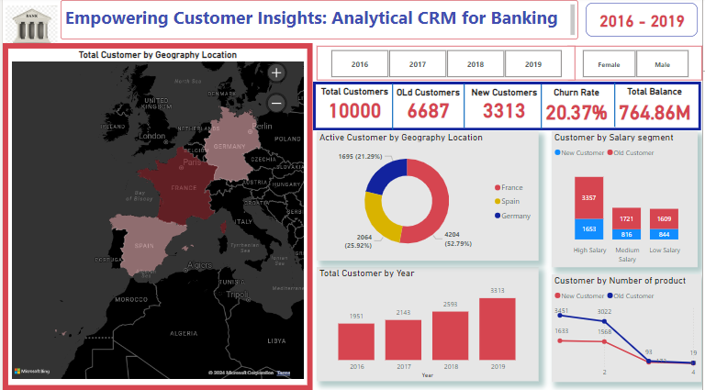
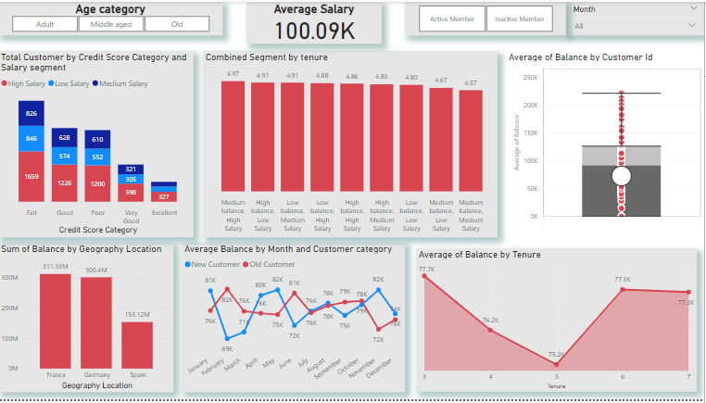
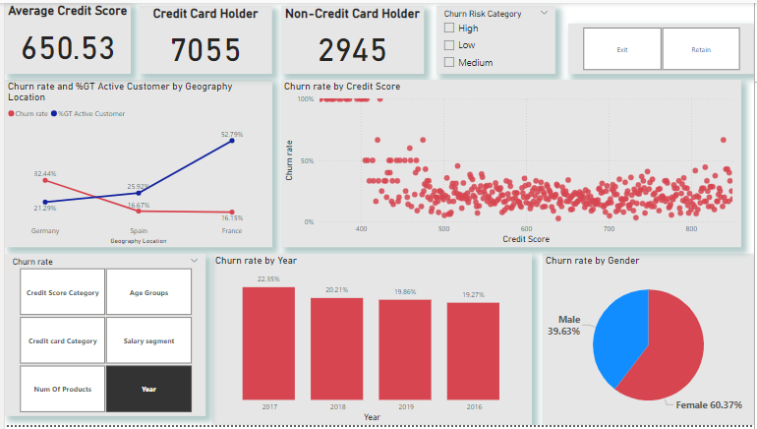
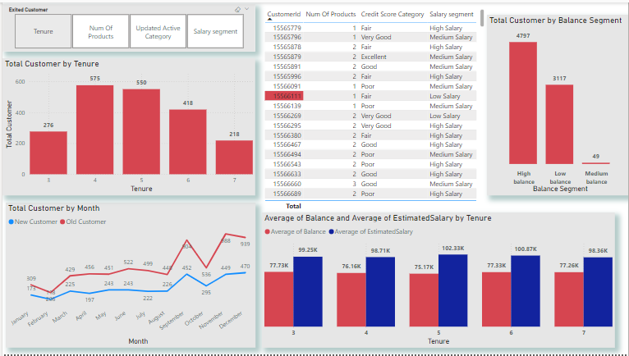
POWER BI REPORT
CUSTOMER PAGE
BALANCE AND SALARY PAGE
CHURN RATE PAGE
ADDITIONAL ANALYSIS PAGE

Slide 13


